Slide 1
NEUROVISION: A BRAIN MRI ABNORMALITY CLASSIFIER
WASSIM KASSEM
ALI EL HAJJ
ZOULFIKAR SHOKOR
SUPERVISED BY: PROF. AMMAR MOHANNA

Slide 2
INTRODUCTION
NeuroVision is an advanced deep-learning system designed to automatically identify and classify key brain abnormalities from MRI scans. Recognizing that accurate, early detection of conditions such as tumors and dementia is critical for patient outcomes, we built a five-class segmentation pipeline:
Background (healthy tissue)
Pituitary Tumor
Meningioma Tumor
Glioma Tumor
Dementia-related Changes

Slide 3
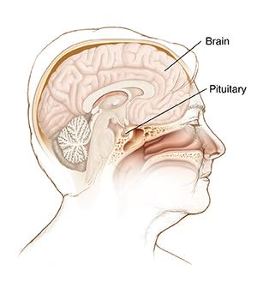
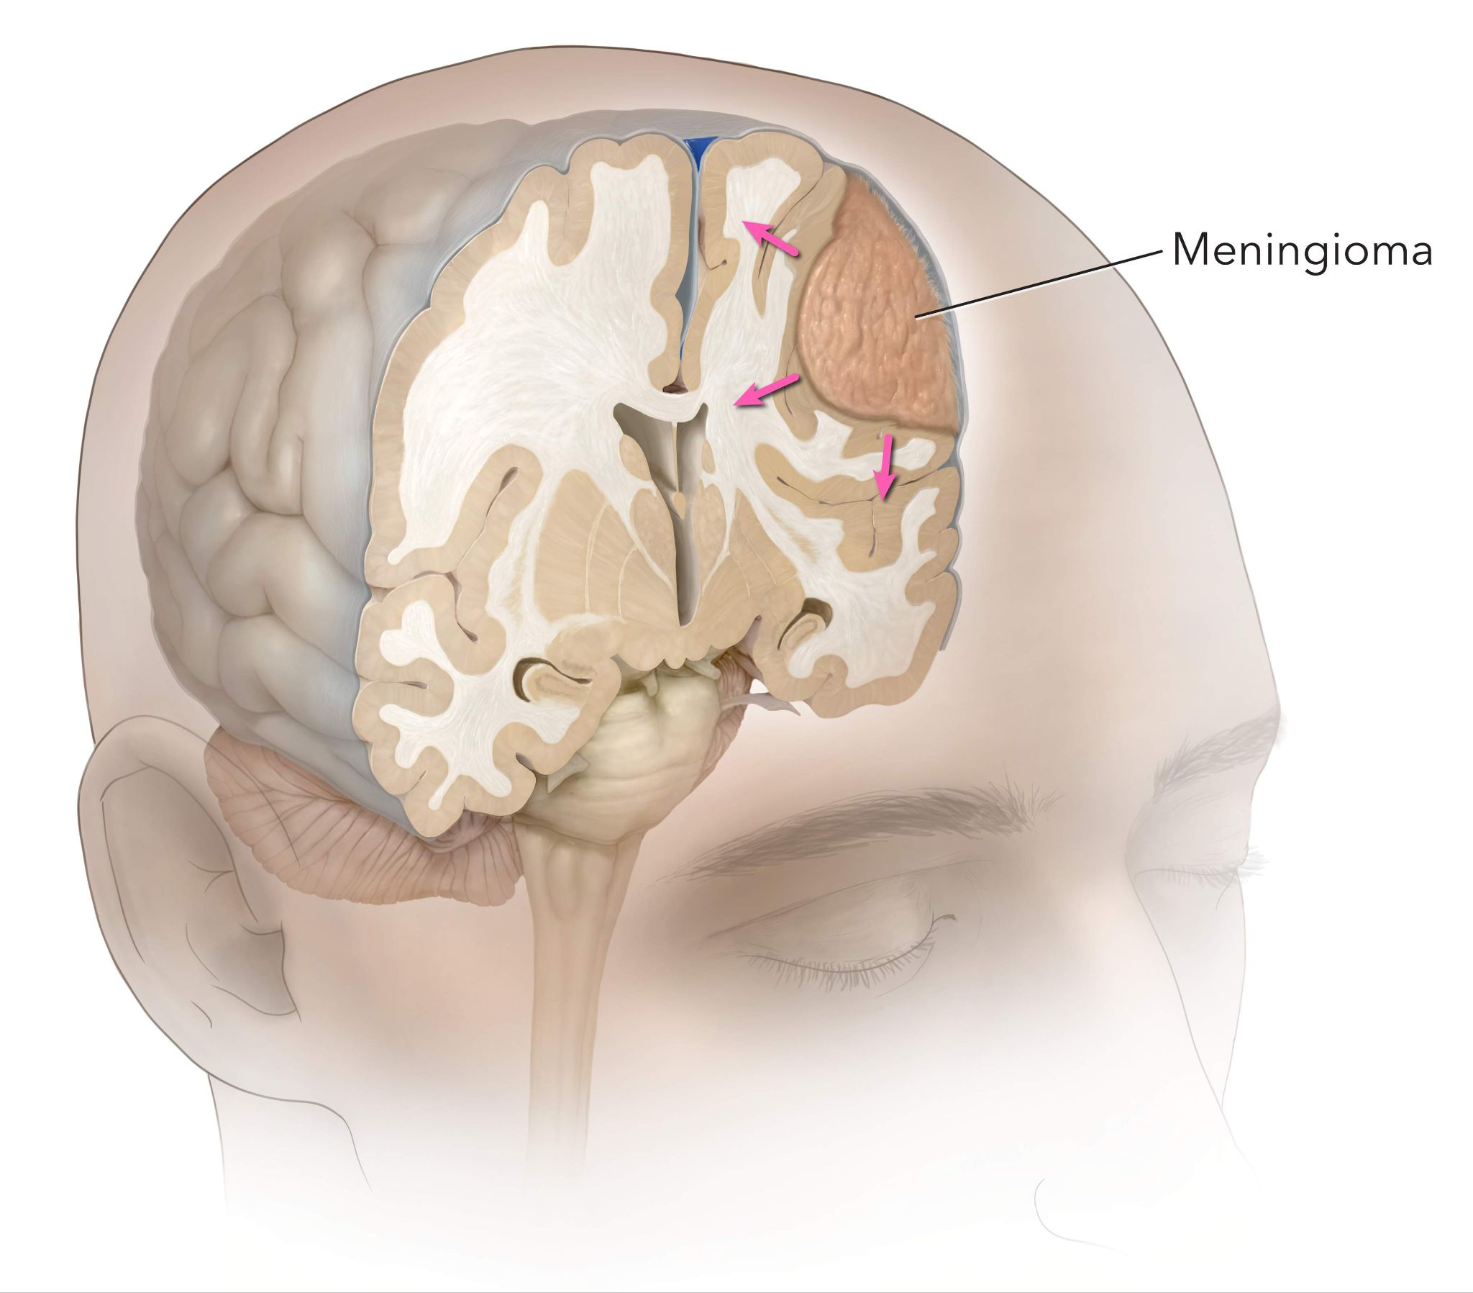
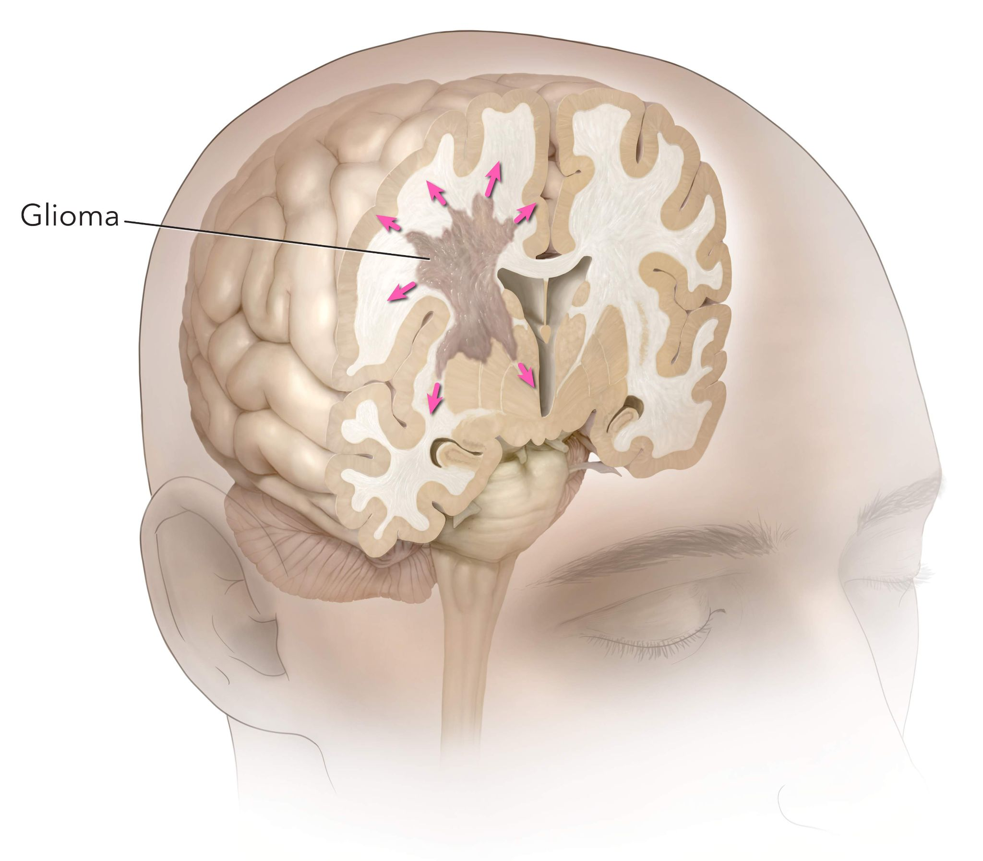
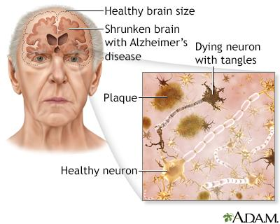
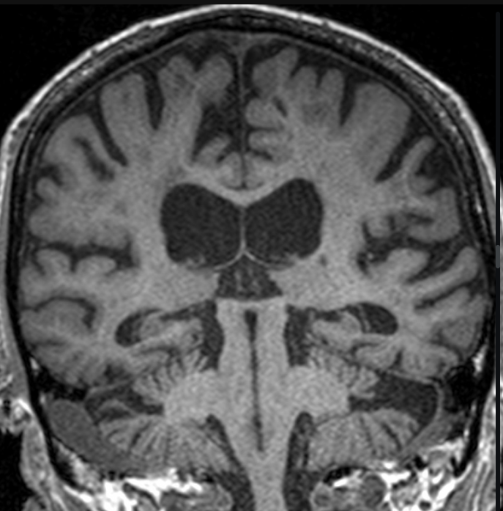
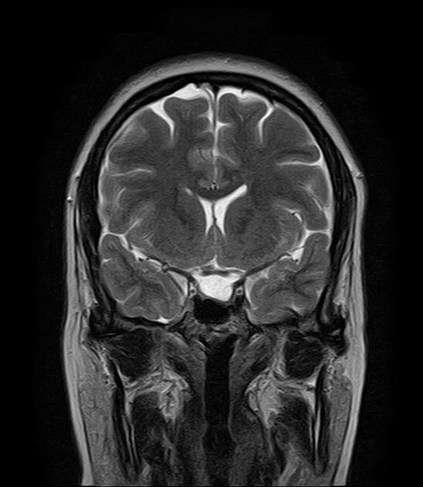
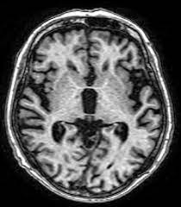
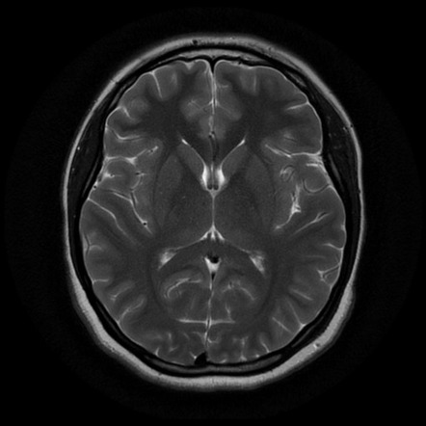
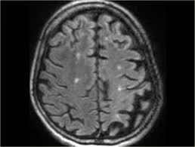
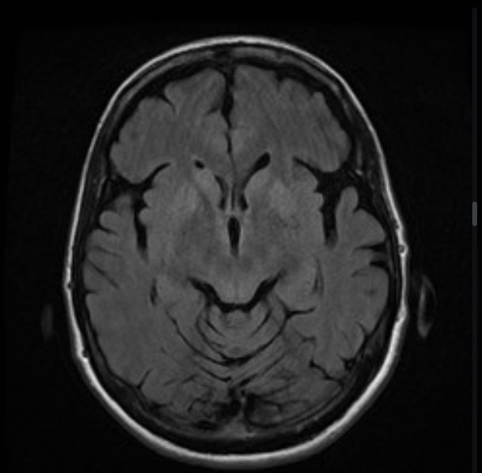
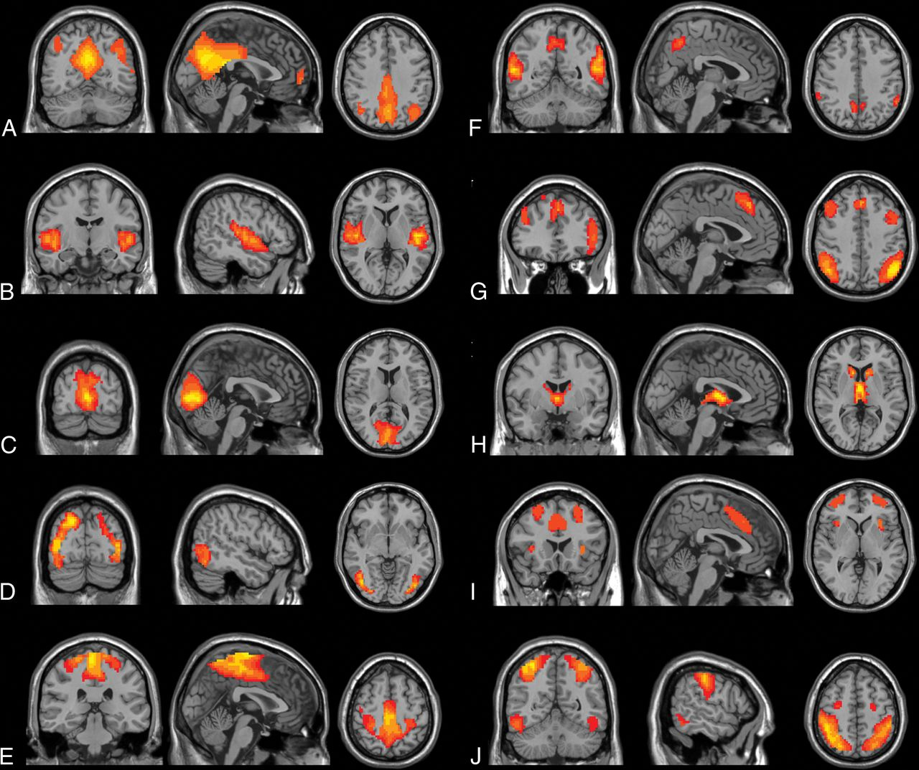
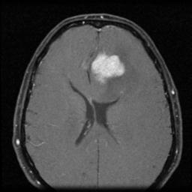
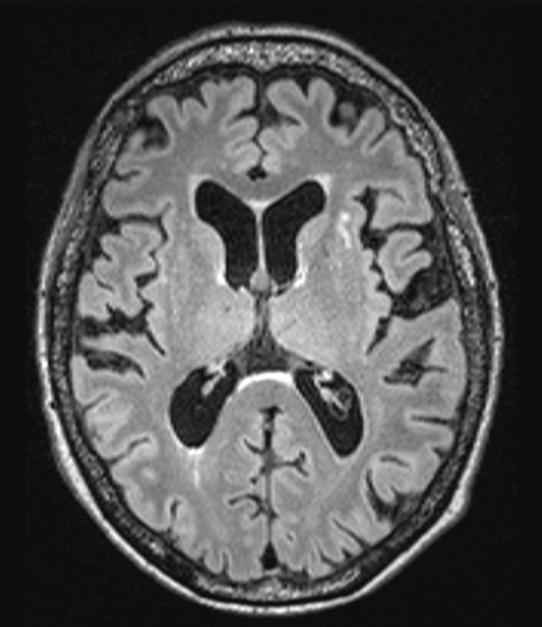
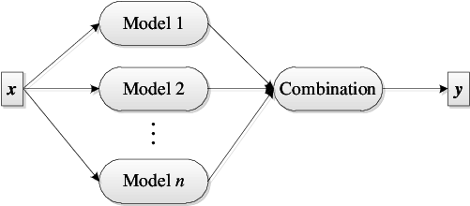
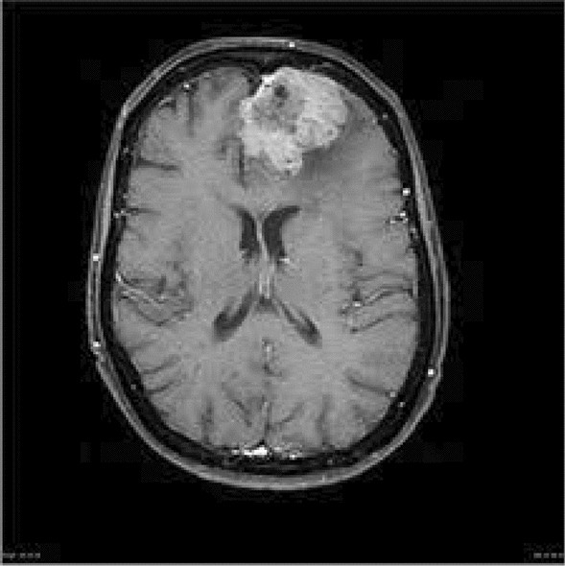
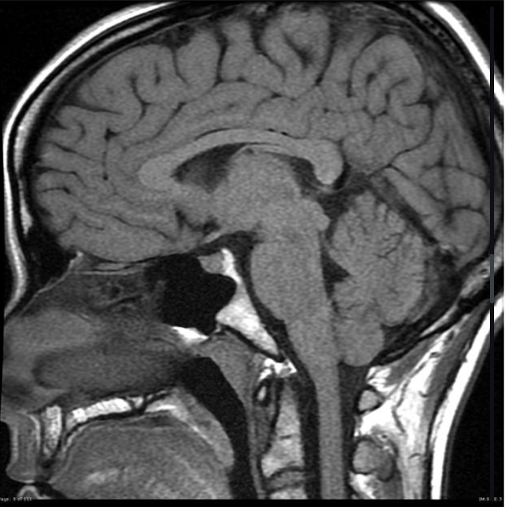
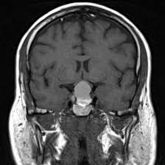
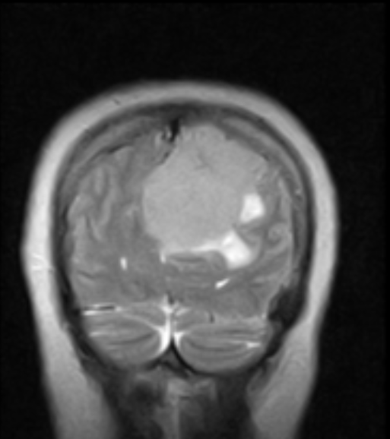
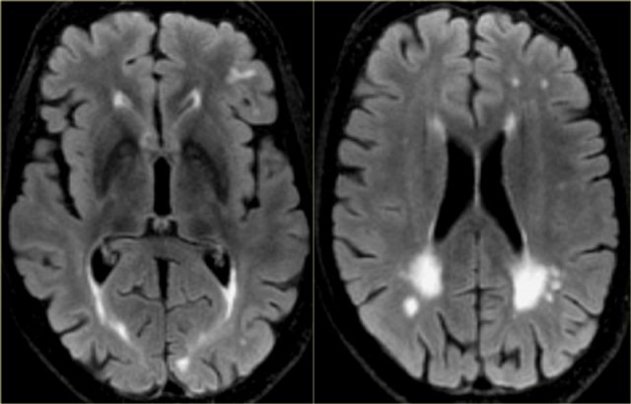
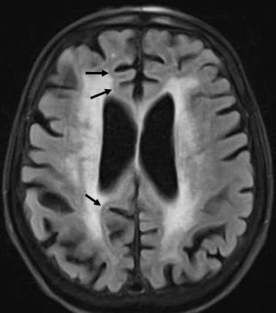
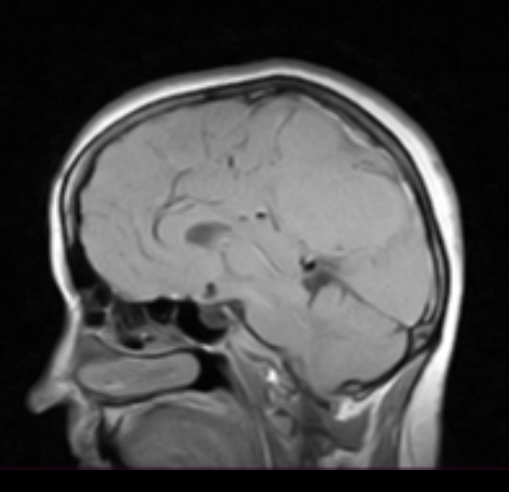
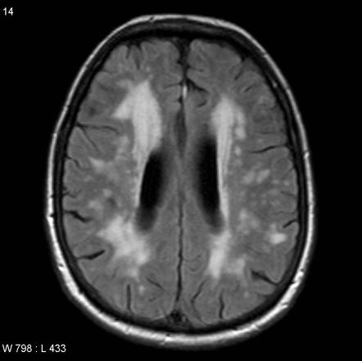
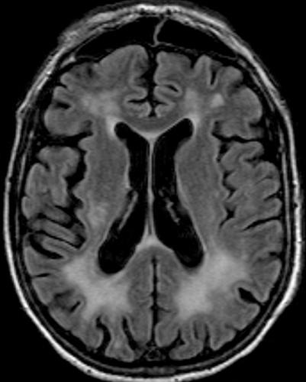
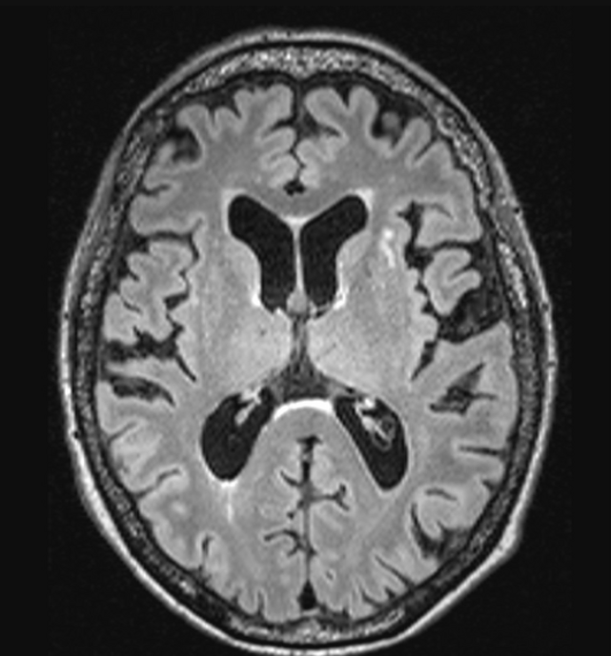
CLASSES OF DETECTION

Slide 4

BUSINESS MODEL & IMPLEMENTATION
🎯 Target Market
Radiology Departments
Emergency Rooms
Outpatient Neurology Clinics
🚀 Delivery Model
Software-as-a-Service (SaaS) or On-Premise install
Direct PACS (DICOM) Integration—no manual file handling
Modular API for EMR/EHR connectivity
Where NeuroVision Fits
Post-Scan: Auto-analyze MRIs on import to PACS
Radiologist Review: AI second opinion during interpretation

Slide 5
BUSINESS DAY-TO-DAY PIPELINE
Automated Segmentation
The Detector models runs , preprocess the images and produced lab labeled maps of regions of interest
Image Acquisition
The MRI scan is performed and the raw sans are sent to the PACS
Quality check
Second proctor model acts as checker for the scans and marks any labeled mask if the error threshold is too high for manual detection
Pre-processing
images are anonymized and snipped from raw scans and sent to segmentation server
Radiologist review
if a label mask is identified it is sent (either via email or employee inbox) to qualified doctor in the field
Reporting and integration
segmentation results after doctor approval is embedded in a report issued by the resident doctor

Slide 6
DATA COLLECTION & PREPROCESSING
Our preprocessing pipeline involved several crucial steps to ensure high-quality, well-structured data for training and evaluation:
•Image Sources:
We collected brain MRI images from publicly available datasets on Roboflow and Kaggle, focusing on abnormalities such as tumors and dementia-related conditions.
•Annotation Remapping:
Initially, image annotations were in YOLOv8 format, which we remapped to COCO format (tried MASK- R CNN but too many support constraints), and then finally converted into TIFF-based segmentation labels compatible with our image-mask pair training pipeline.
•Final Dataset Distribution:
Tumor categories (1,2,3) had approximately 800 images each
Dementia category (4) had approximately 1000 images

Slide 7

CNN #1 – Baseline U-Net
Key Characteristics:
Classic Encoder–Decoder: 4 down-sampling + 4 up-sampling layers, skip connections for spatial detail.
Training from Scratch: No pretrained weights—learns all feature filters directly on MRI data.
Lightweight Architecture: ~7M parameters, enabling fast iteration on smaller GPUs.
Loss & Metrics: Trained with Dice Loss + Categorical Cross-Entropy; monitored Dice Coefficient on validation.
Role in Ensemble: Serves as the “anchor” model—captures broad, generalizable features.
Performance: ~90.8% accuracy

Slide 8
CNN #2 – U-Net with EfficientNetB4 Encoder
What It Does:
Replaces U-Net’s encoder with EfficientNetB4 (MBConv blocks) pretrained on ImageNet.
Decoder remains U-Net style, translating rich features into pixel-wise class predictions.
What Makes It Special:
Transfer Learning Boost: EfficientNet’s compound scaling and squeeze-and-excitation capture edges, textures, and tumor shapes right away.
Accelerated Convergence: Frozen encoder layers ensure stable training—reaches top accuracy in ~20 epochs.
Balanced Compute: Compound scaling maximizes accuracy per FLOP, keeping training/inference costs reasonable.
Role in Ensemble: Provides robust low-/mid-level feature maps that speed up training and sharpen tumor boundaries. Performance: ~92.8% Dice.

Slide 9
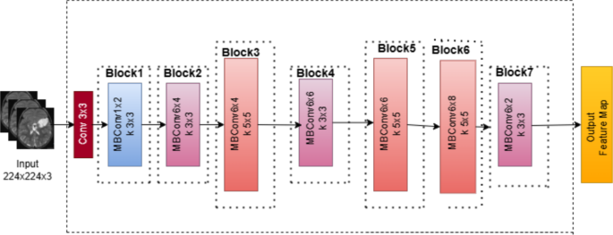

Slide 10
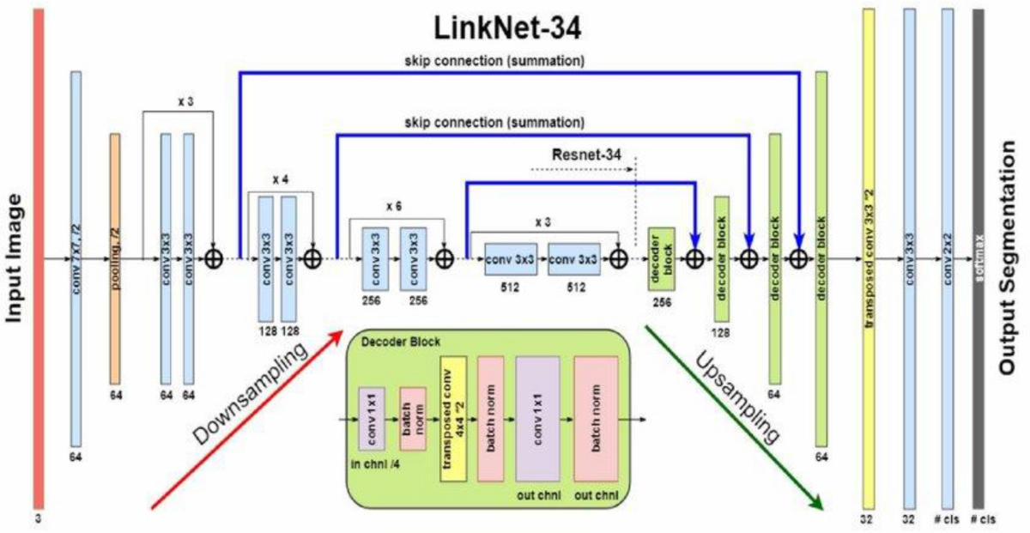
CNN #3 – LinkNet with EfficientNetB7 Encoder
What it does This model pairs a pre-trained EfficientNetB7 encoder with a LinkNet decoder to rapidly extract rich MRI features and rebuild segmentation masks. It captures subtle tissue contrasts via MBConv backbones and uses residual upsampling blocks to merge encoder and decoder information at each step. Dynamic skip connections ensure spatial accuracy throughout.
Why it’s special
Real-Time Inference: Processes a scan in under 25 ms.
High Sensitivity: Spots faint lesions with deep feature extraction.
Resource-Efficient: Separable convolutions keep memory use low.
Performance
Validation Dice: ~92.5 %

Slide 11
CNN #4 – UNet++ (Nested U-Net)
What it does UNet++ wraps each skip connection into mini U-Nets, allowing the network to refine features multiple times at various depths. It progressively fuses edge-level and semantic features so that the final mask benefits from multi-scale context. This design generates smooth, coherent segmentation outputs across different tumor sizes.
Why it’s special
Progressive Refinement: Mini-U-Nets at each skip connection polish the mask step-by-step, eliminating rough edges.
Scale Flexibility: Multi-scale feature fusion adapts seamlessly to both tiny nodules and large masses.
Detail Preservation: Dense skip pathways carry every nuance from encoder to decoder, ensuring no fine structure is lost.
Performance
Validation Dice: ~92.9 %

Slide 12
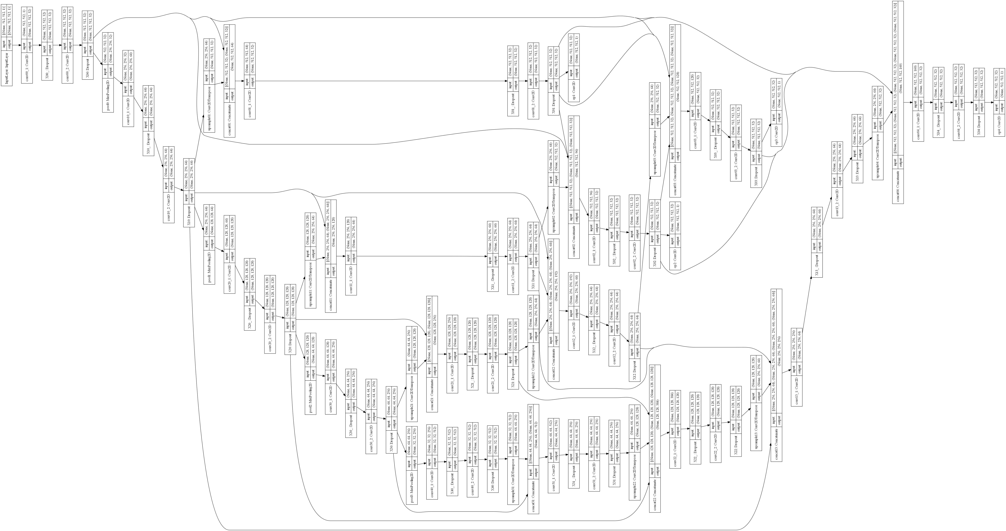

Slide 13
CNN #5 – R2AttU-Net (Recurrent Residual Attention U-Net)
What it does R2AttU-Net enhances U-Net by adding recurrent convolutional blocks that reprocess features twice (r=2) at each stage and attention gates that learn to highlight tumors while suppressing background. It then merges original, refined, and attended feature maps through residual and skip connections before final upsampling, producing highly precise segmentation masks.
Why it’s special
Sharper Boundaries: By reprocessing feature maps twice, the model refines its own predictions, resulting in clean, precise tumor edges.
Tumor Highlighting: Attention gates act like spotlights, boosting the visibility of abnormal regions while dimming surrounding healthy tissue.
Reliable Deep Learning: Residual connections let gradients flow smoothly through many layers, keeping training stable and effective.
Performance
Validation Dice: ~93.0 %

Slide 14
Pipeline
XGBoost
Random Forest Refinement
Soft Voting (Disabled refit)
Generates refined per‐class probability estimates
Smooths and stabilizes the XGBoost predictions, reducing overfitting and variance
Averages the class probabilities from all prior stages
Achieved above 95% dice (net accuracy in this case)

Slide 15
Thank you
Demo incoming…

